Slide 1
Project Cost Management

Slide 2
The Importance of Project Cost Management
IT projects have a poor track record for meeting budget goals
The CHAOS studies found the average cost overrun (the additional percentage or dollar amount by which actual costs exceed estimates) ranged from :
180% in 1994 – 56% in 2004;

Slide 3
What Went Wrong? (IRS & NHS)
1.The U.S. government, especially the Internal Revenue Service (IRS), continues to provide examples of how not to manage costs
Project failures by the IRS in the 1990s cost taxpayers more than $50 billion a year
Also, in 2006, the IRS had a botched upgrade to its fraud-detection software, costing $318 million in fraudulent refunds
In 2008, 400 U.S. government agency IT projects, worth an estimated $25 billion, suffered from poor planning and underperformance
2.The United Kingdom’s National Health Service (NHS) IT modernization program was called the greatest IT disaster in history with an estimated $26 billion cost overrun

Slide 4
What is Cost and Project Cost Management?
Cost is a resource sacrificed or foregone to achieve a specific objective or something given up in exchange
Costs generally measured in monetary units like dollars
Project cost management includes the processes required to ensure that the project is completed within an approved budget

Slide 5
Project Cost Management Processes
Estimating costs:
developing an approximation or estimate of the costs of the resources needed to complete a project
Determining the budget:
allocating the overall cost estimate to individual work items to establish a baseline for measuring performance
Controlling costs:
controlling changes to the project budget

Slide 6
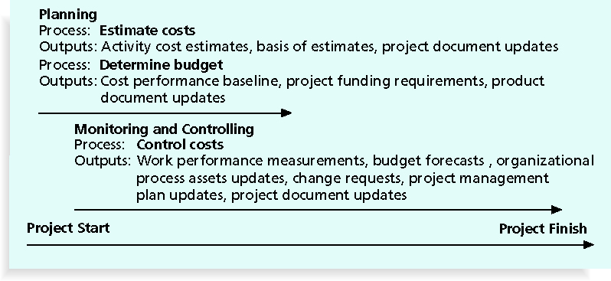
Project Cost Management Summary

Slide 7
Basic Principles of Cost Management
Most senior executive’s are interested in financial terms
Technology project managers must speak their language
Profits
revenues minus expenditures
Profit margin
ratio of revenues to profits
Life cycle costing
total cost of ownership
development plus support costs, for a project
Cash flow analysis
determines the estimated annual costs for a project and the resulting annual cash flow

Slide 8
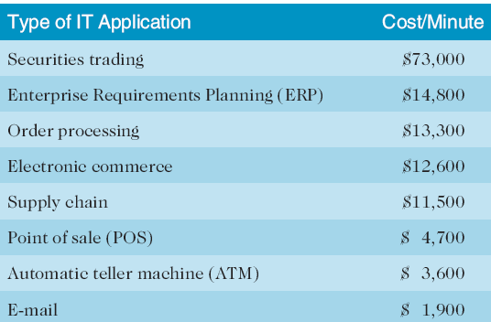
Cost of Downtime for IT Applications

Slide 9
What Went Right?
Many organizations use technology to reduce operational costs
Technology has decreased the costs associated with processing an ATM transaction:
In 1968, the average cost was $5
In 1978, the cost went down to $1.50
In 1988, the cost was just a nickel
In 1998, it only cost a penny
In 2008, the cost was just half a penny!
Investing in green technology and other initiatives has helped both the environment and company bottom lines; Michael Dell, CEO of Dell, reached his goal to make his company “carbon neutral” in 2008

Slide 10
Basic Principles of Cost Management
Tangible costs or benefits are those costs or benefits that an organization can easily measure in dollars
Intangible costs or benefits are costs or benefits that are difficult to measure in monetary terms
Direct costs are costs that can be directly related to producing the products and services of the project

Slide 11
Basic Principles of Cost Management
Indirect costs are costs that are not directly related to the products or services of the project, but are indirectly related to performing the project
Sunk cost is money that has been spent in the past; when deciding what projects to invest in or continue, you should not include sunk costs
Fixed costs
Variable costs

Slide 12
Basic Principles of Cost Management
Learning curve theory
when many items are produced repetitively, the unit cost of those items decreases in a regular pattern as more units are produced
Reserves
are dollars included in a cost estimate to mitigate cost risk:
Contingency reserves
allow for future situations that may be partially planned for (sometimes called known unknowns) and are included in the project cost baseline
Management reserves
allow for future situations that are unpredictable (sometimes called unknown unknowns)

Slide 13
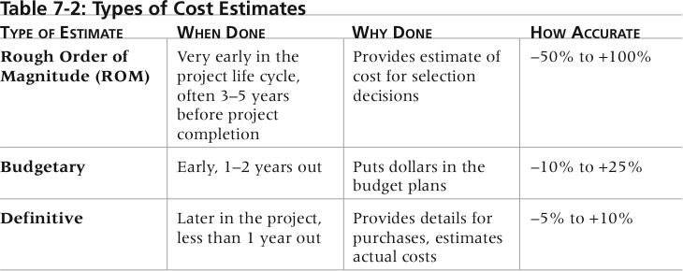
Types of Cost Estimates

Slide 14
Cost Estimation Tools and Techniques
Basic tools and techniques for cost estimates:
Expert Judgment:
Analogous estimate: use the actual cost of a previous, similar project as the basis for estimating the cost of the current project
Bottom-up estimates: involve estimating individual work items or activities and summing them to get a project total
Parametric modeling uses project characteristics (parameters) in a mathematical model to estimate project costs ($/sqft)
Three-Point Estimates

Slide 15
Cost Management Plan
A cost management plan
describes how the organization will manage cost variances on the project
A large percentage of total project costs are often labour costs, so project managers must develop and track estimates for labor

Slide 16
Typical Problems with Technology Cost Estimates
Estimates are done too quickly
Lack of estimating experience
Human beings usually underestimate
Management desires accuracy
Difficult for a manager to address

Slide 17
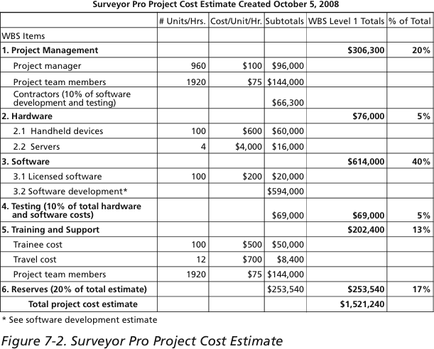
Technology Project Cost Estimate

Slide 18
Determining the Budget
Cost budgeting involves allocating the project cost estimate to individual work items over time
The WBS is a required input to the cost budgeting process since it defines the work items
Create a cost baseline
A time-phased budget project managers use to measure and monitor cost performance

Slide 19
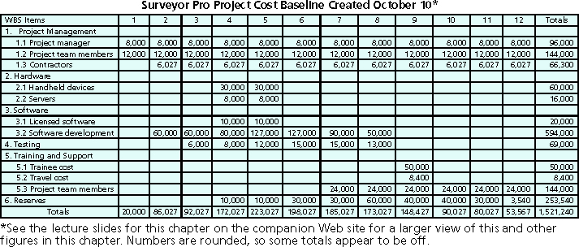
Project Cost Baseline

Slide 20
Controlling Costs
Project cost control includes:
Monitoring cost performance
Ensuring that only appropriate project changes are included in a revised cost baseline
Informing project stakeholders of authorized changes to the project that will affect costs
Many organizations around the globe have problems with cost control

Slide 21
Earned Value Management (EVM)
EVM is a project performance measurement technique that integrates scope, time, and cost data
Given a baseline (original plan plus approved changes), you can determine how well the project is meeting its goals
You must enter actual information periodically to use EVM
More and more organizations around the world are using EVM to help control project costs

Slide 22
Earned Value Management Terms
The planned value (PV), also called the budget, is that portion of the approved total cost estimate planned to be spent on an activity during a given period
Actual cost (AC), is the total of direct and indirect costs incurred in accomplishing work on an activity during a given period
The earned value (EV), is an estimate of the value of the physical work actually completed
EV is based on the original planned costs for the project or activity and the rate at which the team is completing work on the project or activity to date

Slide 23
Rate of Performance
Rate of performance (RP) is the ratio of actual work completed to the percentage of work planned to have been completed at any given time during the life of the project or activity
Example: You have to schedule a module to be developed in 5 days. On Friday your team reports that they are only ½ done the job. Your rate of performance on this section is 50%

Slide 24
Rules of Thumb for Earned Value Numbers
Negative numbers for cost and schedule variance indicate problems in those areas (SV) and (CV)
Problems mean the project is costing more than planned (over budget) or taking longer than planned (behind schedule)

Slide 25
Earned Value Analysis
The Earned Value (EV), formerly called the budgeted cost of
work performed (BCWP) in a time frame
This is the percentage of the work completed multiplied by the
planned value.
Earned Value (EV) = PV (to date) X percent complete
To complete the analysis there are other variables that must
be calculated:
Cost variance (CV): this is the budgeted cost of work
performed (EV) minus the actual cost of work(AC) performed
in a time frame
Cost Variance (CV) = EV – AC
Schedule variance (SV): this is the budgeted cost of work
performed (EV) minus the budgeted cost of work scheduled
(PV) in a time frame
Schedule Variance (SV) = EV – PV in a time frame

Slide 26
Earned Value Analysis
Cost performance index (CPI): this is the ratio of budgeted cost of work performed (EV) to actual cost of work scheduled (AC) and can be used to estimate the projected cost of completing the project.
Cost Performance Index (CPI) = EV / AC in a time frame
Schedule performance index (SPI): this is the ratio of budgeted cost of work performed (EV) to budgeted cost of work scheduled (PV), and can be used to estimate the projected time to complete the project.
Schedule Performance Index (SPI) = EV / PV in a time frame
Note that when the analysis is performed negative numbers for cost and schedule variance indicate problems in those areas.
In this event, the project is costing more then planned or taking longer then planned.
Likewise, CPI and SPI of less then 100% indicate problems in the projects cost and schedule

Slide 27
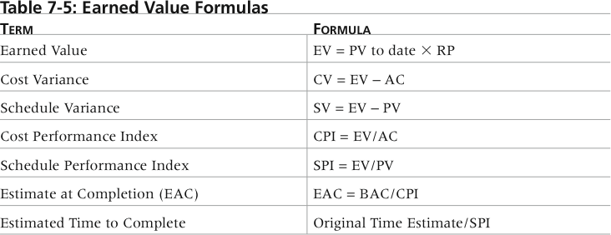
Earned Value Formulas
Also, Earned Value (EV) = PV (to date) X % complete

Slide 28
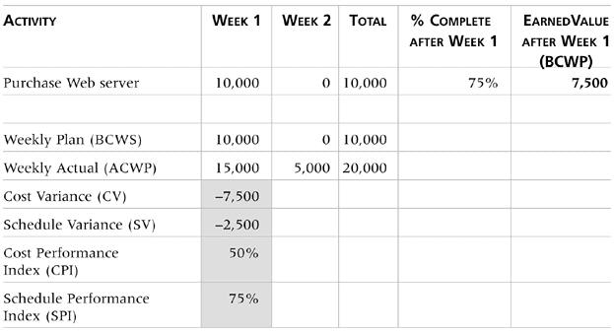
Earned Value Analysis
This example shows a project summary activity for purchasing a Web Server over a one week period for $10,000.

Slide 29
Earned Value Analysis
The Planned Value (PV) is $10,000 and the Actual Cost (AC) is $15,000 in the first week.

Slide 30
Earned Value Analysis
After 1 week the activity is only 75% complete and the Earned Value (EV) is calculated as follows:
EV = $10,000 X 75% = $7,500 (PV*%complete)
for the week

Slide 31
Earned Value Analysis
The Cost Variance for the project activity is calculated as follows: CV = $7,500 - $15,000 = ($7,500) (EV-AC) for the week

Slide 32
Earned Value Analysis
The Schedule Variance for the activity is calculated as follows: SV = $7,500 - $10,000 = ($2,500) (EV-PV) for the week

Slide 33
Earned Value Analysis
The Cost Performance Index for the activity is calculated as follows: CPI = $7,500 / $15,000 = 50% (EV/AC) for the week

Slide 34
Earned Value Analysis
The Schedule Performance Index for the activity is calculated as follows: SPI = $7,500 / $10,000 = 75% (EV/PV) for the week

Slide 35
Rules of Thumb for Earned Value Numbers
The CPI can be used to calculate the estimate at completion (EAC)—an estimate of what it will cost to complete the project based on performance to date
the budget at completion (BAC) is the original total budget for the project

Slide 36
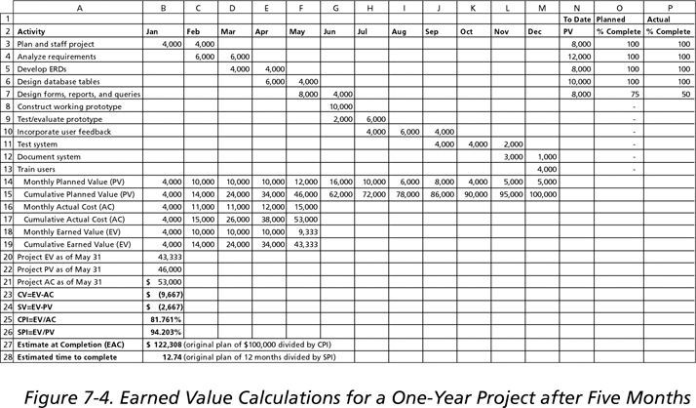
Earned Value Calculations for a One-Year Project After Five Months

Slide 37
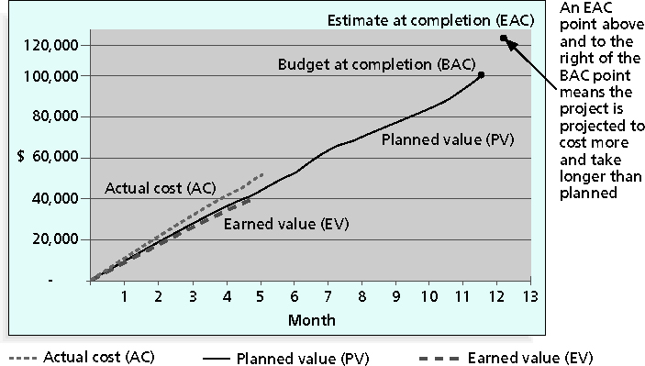
Earned Value Chart for Project after Five Months

Slide 38
Chapter Summary
Project cost management is a traditionally weak area of IT projects, and project managers must work to improve their ability to deliver projects within approved budgets
Main processes include:
Estimate costs
Determine the budget
Control costs

